Slide 1
hackers, assemble!
with avantika

Slide 2
~# whoami
avantika (@iamavu)
a girl who dabbles in security
makes music sometimes
loves memes :D
breaks things
has bad handwriting D:

Slide 3
what we hacking today?
your fear of assembly language

Slide 4
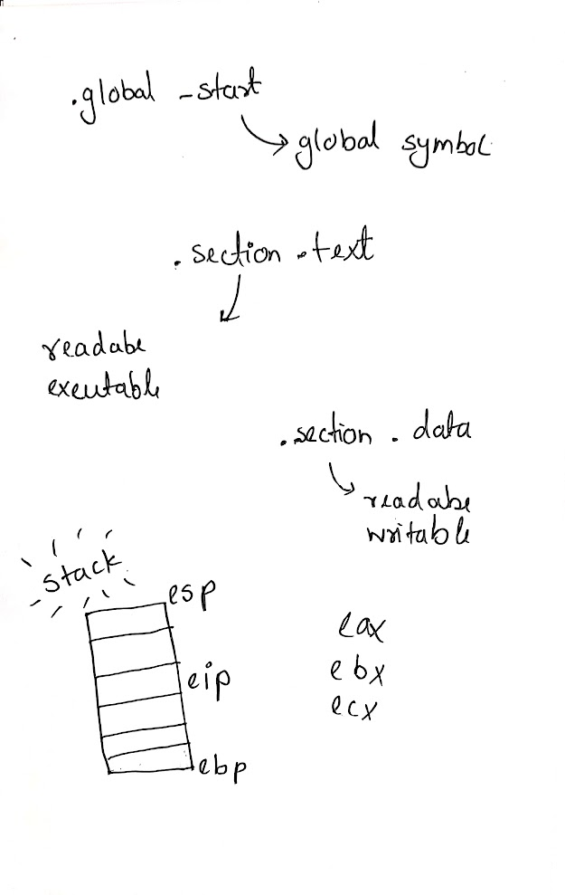

Slide 5
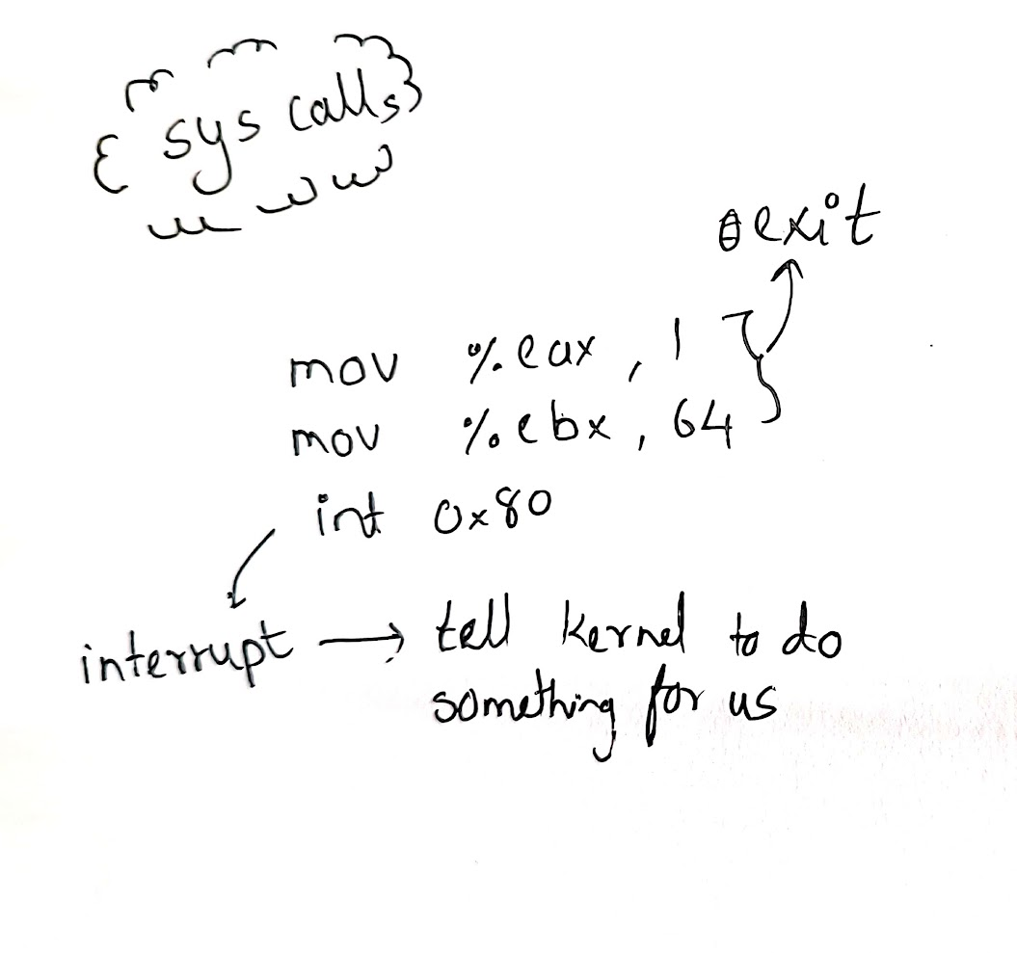

Slide 6
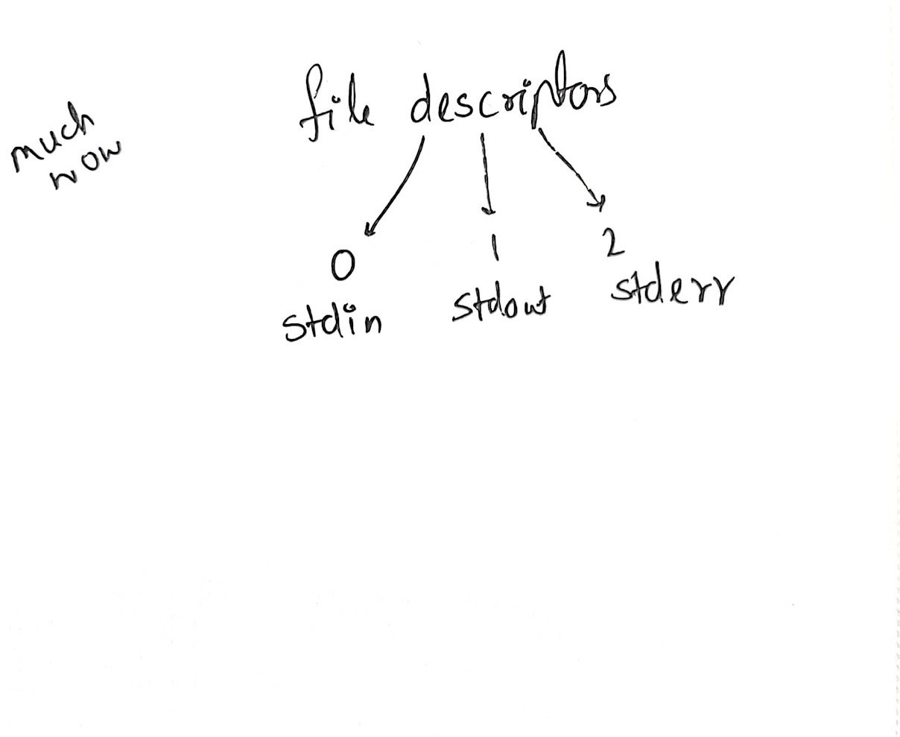

Slide 7
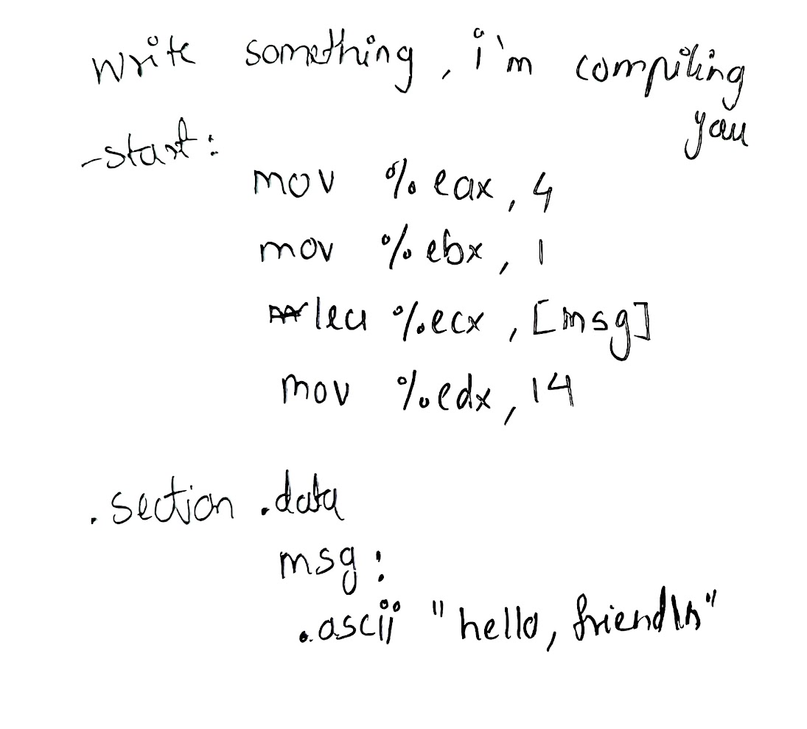

Slide 8
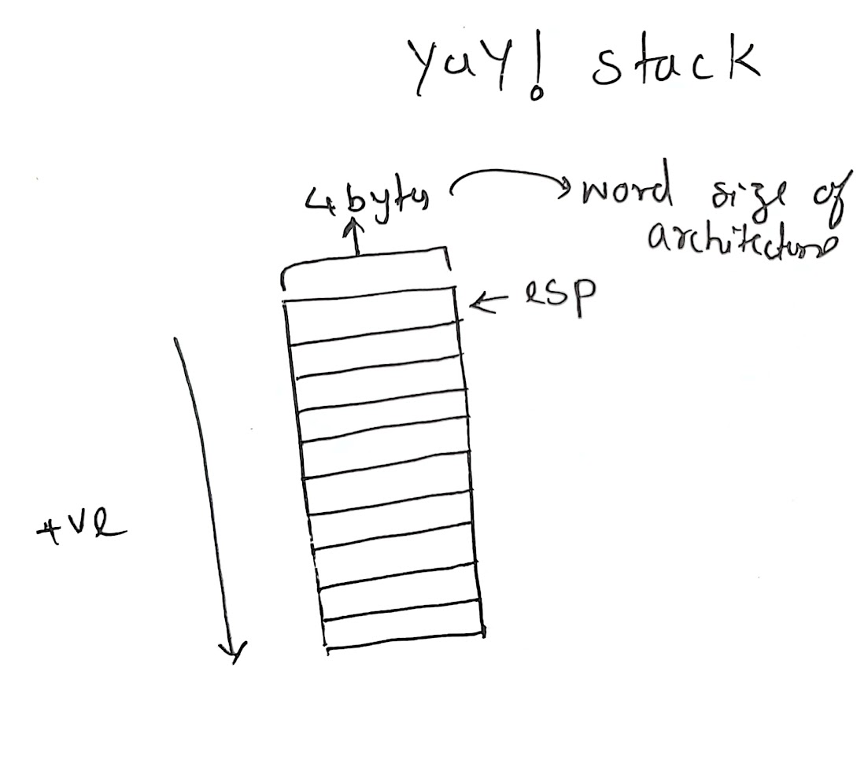

Slide 9
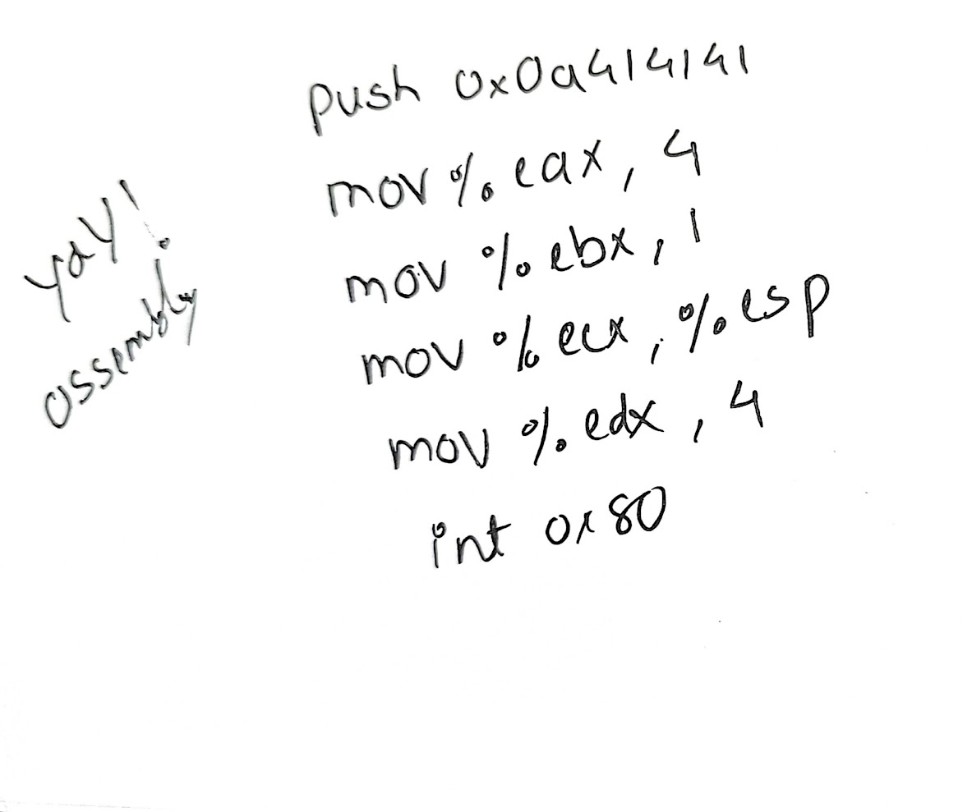

Slide 10
q&a

